Slide 1
Quantitative methods
for typologists
using R
Teach In - ALT
University of Texas at Austin
December 14th 2022
Sandra Auderset (MPI-EVA, Leipzig)
Olena Shcherbakova (MPI-EVA, Leipzig)
Adam Tallman (FSU Jena)

Slide 2
Schedule overview
BLOCK | CONTENT | BY
Morning I | conceptual background on statistics research questions/testable hypotheses intro to using base R, opening files | Adam
Morning II | intro to tidyverse, basic concepts data wrangling (based on Glottolog and WALS) | Olena
Afternoon I | visualizing data with ggplot 2 maps | Sandra
Afternoon II | practice session | Sandra and Adam
ADDENDUM: Please install SplitsTree4 for the practice session:
https://software-ab.cs.uni-tuebingen.de/download/splitstree4/welcome.html

Slide 3
Goals
Introduce coding with R
(sorry if you already have a strong background)
Show how how to graph with R
Give you enough background so that you have the confidence to try some of the more popular statistical models in your own research.
Neighbornets (with clause linkage data)
(Bickel 2010)
Multilevel models (with phoneme inventories & pop size)
(Moran, McCloy & Wright 2012)

Slide 4
What we are not going to do
Give you some sort of formula for when you should and should not use certain types of statistical analysis.

Slide 5
Introduction to R with some concepts from probability and statistics
Adam J.R. Tallman

Slide 6
Overview
Installing R
R as a language
Types of objects in R, learning to read errors, simulations
Descriptive statistics
Measures of dispersion, measures of central tendency, sample size
Plotting in base R (how are the plots made)
Frequency distributions and probability distributions
The normal distribution, binomial distribution, kurtosis etc.
“Basic” test statistics
t-test, chi-squared test, F statistic, linear models, analysis of variance
Installing packages and reading datasets

Slide 7
Overview
Installing R
R as a language
Types of objects in R, learning to read errors, simulations
Descriptive statistics
Measures of dispersion etc.
Distributions
Conventional test statistics
chi-squared, test,linear models, analysis of variance

Slide 8
Datasets
levshina_ldt.csv
araonavowels.csv
inventories.clean.csv

Slide 9
R as a language
R is a calculator
R has ``functions”
You can use R to write new functions
R stores data in different types with different structures
You have to know those structures to use functions

Slide 10
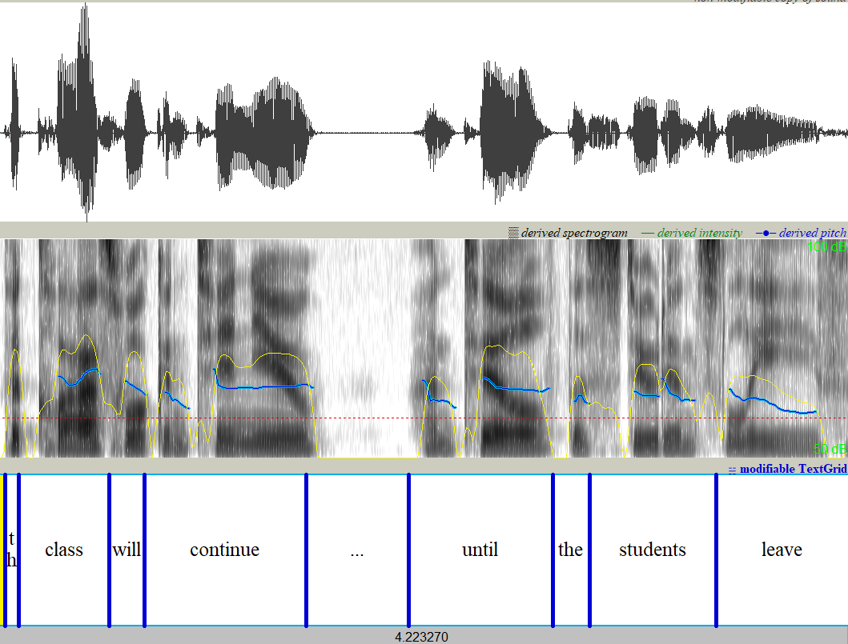
R as a language (atomic vectors)

Slide 11
R as a language (atomic vectors)
An atomic vector is a single vector (like a list) of data.
The following would be atomic vectors - say a short list of morphemes in English and an allomorphy score for each of them.
morphemes <- c("The", "class", "will", "continue", "until", "the", "participant", "-s", "leave") pos <- c("Det", "Noun", "Aux", "Verb", "Prep", "Det", "Noun", "PL", "Verb") duration.seconds <- c("0.07538","0.382087","0.130065","0.605475", "0.399165", "0.107640", "0.556140", "0.121781", "0.322920") lexical <- c(F, T, F, T, F, F, T, F, T)

Slide 12
Data types
Vectors have a number of types: numeric, integers, characters, logicals.
Our morphemes is a vector of characters (they have characters around them)
Our word.class is a vector of characters
Our mean.length.seconds is a vector of numerics (or it should be)
Our lexical variable is logical (either true or false)

Slide 13
Functions, types and error messages
Functions do something to a number or a combination of numbers.
mean() and table() are examples of functions.
mean(x) gives you the mean of a list of numeric numbers in vector x.
table(x) gives you a frequency table for the categorical values.
table(pos)
## pos ## Aux Det Noun PL Prep Verb ## 1 2 2 1 1 2

Slide 14
Functions, types, and error messages
R complains if you try to make functions do something with the wrong type.
mean(pos)
## Warning in mean.default(pos): argument is not numeric or logical: returning NA
## [1] NA
R even complains if you try to apply functions of data that should be of one type but it has read in as a different type.
mean(duration.seconds)
## Warning in mean.default(duration.seconds): argument is not numeric or logical: ## returning NA
## [1] NA

Slide 15
Functions, types, and error messages
When you get this message you have to change the data type
The following line of code states, assign duration.s.numeric to a vector that is duration.s, but where all the elements are numeric.
duration.seconds.numeric <- as.numeric(duration.seconds) duration.seconds.numeric
## [1] 0.075380 0.382087 0.130065 0.605475 0.399165 0.107640 0.556140 0.121781 ## [9] 0.322920
duration.seconds
## [1] "0.07538" "0.382087" "0.130065" "0.605475" "0.399165" "0.107640" "0.556140" ## [8] "0.121781" "0.322920"
mean(duration.seconds.numeric)
## [1] 0.3000726

Slide 16
Math in R
You can do anything in R that you can do with a calculator.
1+1
## [1] 2
1*2
## [1] 2
2^2 #2 to the power of 2
## [1] 4
sqrt(2) #the square root of 2
## [1] 1.414214

Slide 17
Math in R
You can apply math to vectors
duration.milliseconds <- duration.seconds.numeric * 1000 # this means multiply each value by 1000 duration.seconds.numeric
## [1] 0.075380 0.382087 0.130065 0.605475 0.399165 0.107640 0.556140 0.121781 ## [9] 0.322920
duration.milliseconds
## [1] 75.380 382.087 130.065 605.475 399.165 107.640 556.140 121.781 322.920
duration.ms.normalized <- (duration.milliseconds-min(duration.milliseconds))/(max(duration.milliseconds)-min(duration.milliseconds)) duration.ms.normalized
## [1] -224.69256 82.01444 -170.00756 305.40244 99.09244 -192.43256 256.06744 ## [8] -178.29156 22.84744

Slide 18
Lists and Vectors
Lists are coded the same way as vectors, but you use list() instead of c().
The main difference between lists and vectors, is that lists have have whole R objects
allomorphs <- list(c("ðə", "ði"), "klæs", c("wɪl, l"), "kəntɪnjuʊ", "ʌntɪl", c("ðə", "ði"), "stuʊdənt", c("s", "z", "əz") , c("lijv", "lɛft")) allomorphs
## [[1]] ## [1] "ðə" "ði" ## ## [[2]] ## [1] "klæs" ## ## [[3]] ## [1] "wɪl, l" ## ## [[4]] ## [1] "kəntɪnjuʊ" ## ## [[5]] ## [1] "ʌntɪl" ## ## [[6]] ## [1] "ðə" "ði" ## ## [[7]] ## [1] "stuʊdənt" ## ## [[8]] ## [1] "s" "z" "əz" ## ## [[9]] ## [1] "lijv" "lɛft"

Slide 19
Dataframes
Dataframes are two dimensional versions of lists
A dataframe is R’s version of a spreadsheet.
Dataframes can be lists of vectorsː
sentence <- data.frame(morphemes, pos, lexical, duration.milliseconds)

Slide 20
Dataframe
sentence
## morphemes pos lexical duration.milliseconds ## 1 The Det FALSE 75.380 ## 2 class Noun TRUE 382.087 ## 3 will Aux FALSE 130.065 ## 4 continue Verb TRUE 605.475 ## 5 until Prep FALSE 399.165 ## 6 the Det FALSE 107.640 ## 7 participant Noun TRUE 556.140 ## 8 -s PL FALSE 121.781 ## 9 leave Verb TRUE 322.920

Slide 21
Dataframes and their vectors
You can refer to a variable of a dataframe with ’$' - think of it like the genitive 's in English - so ``sentence$morphemes” lists the dataframe (sentence)’s vector (morpheme).
sentence$morphemes
## [1] "The" "class" "will" "continue" "until" ## [6] "the" "participant" "-s" "leave"

Slide 22
Column binding and row binding
Two important ways of combining vectors is with cbind() and with rbind()
Use cbind() when you want to add a column or stick vectors together by their columns
Use rbind() when you want to add a row or stick vectors together by their rows.

Slide 23
Column binding and row binding

Slide 24
Installing and using packages
``Base R” is what you get in terms of functions and data sets without installing any packages.
To install a package use the function install.packages(“package”)
After that load it with library(package) (no quotations this time)

Slide 25
Other packages
library(sm)
## Warning: package 'sm' was built under R version 4.2.2
## Package 'sm', version 2.2-5.7: type help(sm) for summary information
library(nhstplot)
## Warning: package 'nhstplot' was built under R version 4.2.2

Slide 26
Descriptive statistics
Descriptive statistics is about describing and comparing distributions (minimally)
Some core concepts of descriptive statistics
Sample
Frequency
Central tendency
Dispersion
Limits
Skew
Distribution

Slide 27
Descriptive statistics
Central tendency of a variable can be measured by mean, median
mean(duration.milliseconds)
## [1] 300.0726
median(duration.milliseconds)
## [1] 322.92
Dispersion can be measured by the standard deviation or variance
sd(duration.milliseconds)
## [1] 201.2823
var(duration.milliseconds)
## [1] 40514.54

Slide 28
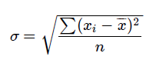
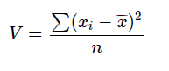
Descriptive statistics

Slide 29
Descriptive statistics
The sample refers to the number of elements of a variable
length(duration.milliseconds)
## [1] 9
Frequency is just how often some discrete value occurs for a variable
table(pos)
## pos ## Aux Det Noun PL Prep Verb ## 1 2 2 1 1 2
table(pos)/ length(pos)
## pos ## Aux Det Noun PL Prep Verb ## 0.1111111 0.2222222 0.2222222 0.1111111 0.1111111 0.2222222

Slide 30
Measurements of dispersion/spread
Standard deviation: sd(x)
-Variance: var(x)
## Distributions
The distribution of a variable is a description of the relative number of times a value occurs or some range of values occurs.
Discrete

Slide 31
Distributions
Distributionː for a variable, (a function that maps) the values over a sample space
There are two types of distributions
Continuous distributions: the variable is continuous (numeric)
Discrete distributions: the variable is discrete (character, level)

Slide 32
Distributions
Examples of Discrete distributions in linguistics
Frequencies of sets of words, the basic word order of a set of languages.
Examples of Continuous distributions in linguistics
Speaker population of a set of languages, number of vowels/consonants of a language, VOT values of a consonant, Reaction times in a psycholinguistics experiment

Slide 33
Random variables
A random variable (stochastic variable) is a function which maps possible outcomes and their relative probabilities to some measurable sample space.
Random variables have distributions defined by mathematical properties.
We can talk about discrete random variables versus continuous random variables

Slide 34
Random variable (an example)
We can represent the process of rolling a die as a random variable X
X will take on integer values from 1 to 6
X does not represent a number but an “unrealized outcome of a random process”
A specific instance of X is a specific number

Slide 35
Random variable
R can simulate random variables with different distributions (continuous, discrete)
Simulating a die roll
die <- 1:6 # numbers 1 through 6 sample(die, 2, replace=TRUE)
## [1] 4 5

Slide 36
Random variable
We can even create that random variable we just mentioned
X <- function() { die <- 1:6 sample(die, size =1, replace=TRUE) } X()
## [1] 1

Slide 37
Simulations in statistics, science
Simulations are frequently used in science to help researchers model different consequences of their theories (how would the data pattern if our theory was correct and/or false?)
Simulations are used by statisticians or statistical software engineers to probe properties of their statistical models, algorithms etc. (how would my model behave under these conditions?)
Notes:
… Or some competing point were true.
How does our statistical software behave under x conditions

Slide 38
Simulations and pedagogy
Simulations are a useful teaching tool in statistics …
Notes:
… because we can map out the consequences of combining the different pieces of distributions in different ways and see how changes in the underlying data would give us different results in our statistical tests.

Slide 39
Simulations and hypothesis testing
An aside about why simulations are important:
It’s often claimed that a hypothesis is not scientific unless it is falsifiable (Popper)
A good way of showing that your test is falsifiable would be to simulate a state of affairs that would be true if your hypothesis was false.

Slide 40
Simulations and hypothesis testing
Simulations, therefore, play an important part in counterfactual thinking or arguments from coincidence
Even traditional statistical tests are based on null hypotheses, a state of affairs that would be true if your hypothesis was not (a simulation in a sense)
Traditional null hypothesis testing just doesn’t force you to be explicit and defend the structure of your null hypothesis

Slide 41
Uniform distribution
A uniform distribution refers to a case where every value is just as likely to occur.
you can use the function runif() to simulate values out of a uniform distribution
n = number of values; min = 0 (with a minimum value of 0), max = with a maximum value of 1
if you just use this code over and
runif(n = 1, min =0, max = 1)
## [1] 0.3078537
runif(n = 1, min =0, max = 1)
## [1] 0.2646943
runif(n = 1, min =0, max = 1)
## [1] 0.2214549

Slide 42
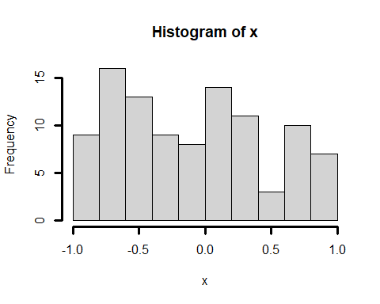
Uniform distribution
we can assign a set of numbers generated from a random distribution to `x’.
x <- runif(n=100, min=-1, max=1) hist(x, lwd=3)

Slide 43
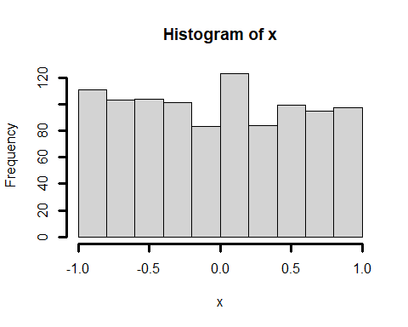
Uniform distribution
x <- runif(n=1000, min=-1, max=1) hist(x, lwd=3)

Slide 44
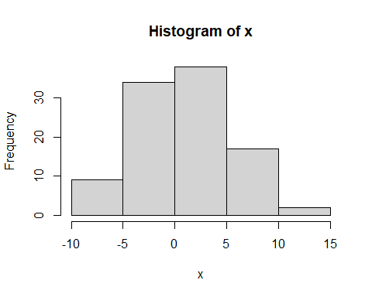
Normal/Gaussian distribution
We can simulate values of a normal" /Gaussian” distribution
rnorm(n = sample size, m = mean, sd = standard deviation)
x <- rnorm(n =100, m = 1, sd= 4) hist(x)

Slide 45
Normal/Gaussian distribution
We can simulate values of a normal/Gaussian distribution
The normal distribution doesn’t have ``limits”, it just tails on forever.
x1 <- rnorm(n =100, m = 1, sd= 4)

Slide 46
Normal distribution
install.packages("sm")
## Warning: package 'sm' is in use and will not be installed

Slide 47
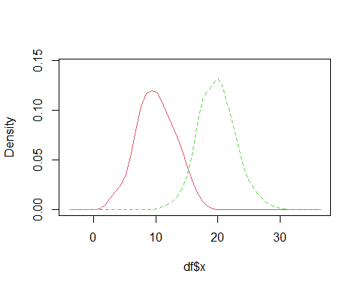
Normal / Gaussian distribution
Normally distributed data can have different means
x1 <- cbind(x = rnorm(n=500, m=10, sd=3), group = rep("x1", times=100)) x2 <- cbind(x = rnorm(n = 500, m=20, sd=3), group = rep("x2", times =100)) df <- as.data.frame(rbind(x1, x2)) df$x <- as.numeric(df$x) sm.density.compare(df$x, df$group)

Slide 48
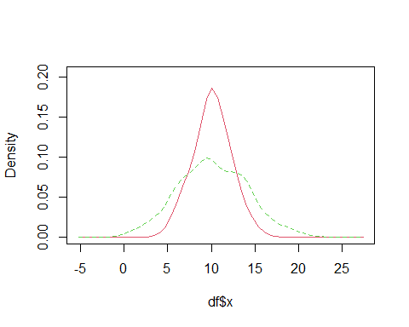
Normal / Gaussian distribution
Normally distributed data can have different means
x1 <- cbind(x = rnorm(n=400, m=10, sd=2), group = rep("x1", times=100)) x2 <- cbind(x = rnorm(n = 400, m=10, sd=4), group = rep("x2", times =100)) df <- as.data.frame(rbind(x1, x2)) df$x <- as.numeric(df$x) sm.density.compare(df$x, df$group)

Slide 49
Vowels in Araona
araonavowels <- read.csv("/Users/Adam/Desktop/database2.csv", header=TRUE) araonavowels <- araonavowels[araonavowels$Vowel == "i" | araonavowels$Vowel == "e" | araonavowels$Vowel == "a" | araonavowels$Vowel =="o",] sm.density.compare(araonavowels$F1_.Hz., araonavowels$Vowel, xlab="F1 for vowels", col= 1:4, xlim =c(200, 1000)) legend("topright", legend = levels(as.factor(araonavowels$Vowel)), lty =1, col=1:4)

Slide 50
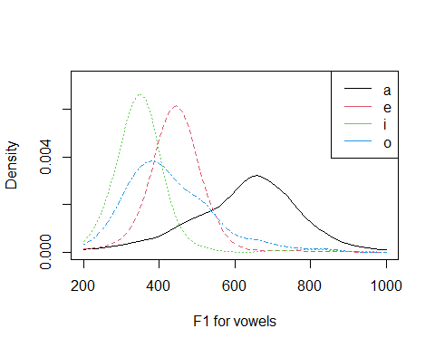

Slide 51
Binomial distribution
rnbinom(#observations, #trials/observations, probability of success)
Binomial distributions are based on an observation that takes one of two values (“one success”, “one failure”)
10 observations, 1 time, 0.5 probability of success
rbinom(10, 1, p=0.5)
## [1] 1 1 1 1 1 0 1 1 0 1
10 observations, 4 times, 0.5 probability of success
rbinom(10, 4, p=0.5)
## [1] 3 4 3 2 4 2 2 2 2 3

Slide 52
How to talk about distributions cont.
Word of real numbers:
In terms of relative frequency, sample, central tendency and spread.
World of probability:
In terms of probability mass function(s)
In terms of cumulative mass function(s)

Slide 53
Discrete Random variables (probability mass function)
Probability mass function: for a value x of a random variable, the PMF gives the relative probability of some x occurring
The probability that a dice lands on 1, is 1/6.

Slide 54
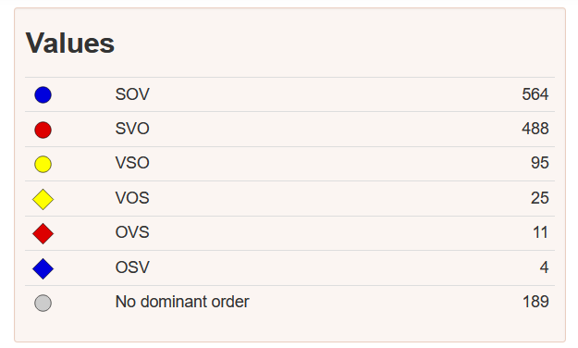
Discrete Random variables (probability mass function)
W as a random variable that tells you how likely a language is to have a given word order.
https://wals.info/feature/81A#2/18.0/152.9

Slide 55
Discrete Random variables (probability mass function)
wordorders <- c("SOV", "SVO", "VSO", "VOS", "OVS", "OSV", "none") frequencies <- data.frame(564, 488, 95, 25, 11, 4, 189) colnames(frequencies) <- wordorders frequencies
## SOV SVO VSO VOS OVS OSV none ## 1 564 488 95 25 11 4 189
round(frequencies / sum(frequencies), digits=4)
## SOV SVO VSO VOS OVS OSV none ## 1 0.4099 0.3547 0.069 0.0182 0.008 0.0029 0.1374

Slide 56
Discrete Random variables (cumulative mass function)
cumulative mass function: the probability that a random variable will be less than or equal to a particular value.
The CMF for the value 2 for a dice roll is 1/6 + 1/6

Slide 57
Discrete Random variables (cumulative distribution function)
For word order the CDF does not make sense, but it does make sense for ranked values like the number of tenses a language has
tense.values <- c("Nopasttense", "Onepasttense", "2-3remotepasts", "4>remotepasts") frequencies <- data.frame(88, 94, 37, 2) colnames(frequencies) <- tense.values frequencies
## Nopasttense Onepasttense 2-3remotepasts 4>remotepasts ## 1 88 94 37 2
freq.list <- data.frame(list((88), (88+94), (88+94+37), (88+94+37+2))) tense.cdf <- freq.list / sum(frequencies) colnames(tense.cdf) <- tense.values tense.cdf
## Nopasttense Onepasttense 2-3remotepasts 4>remotepasts ## 1 0.39819 0.8235294 0.9909502 1

Slide 58
Continuous random variables
It doesn’t make sense to talk probability mass functions for continuous variables
What’s the probability that someone weighs exactly 80 kg?
What’s the probability that a high tone will be produced with a pitch peak of exactly 80 Hz?

Slide 59
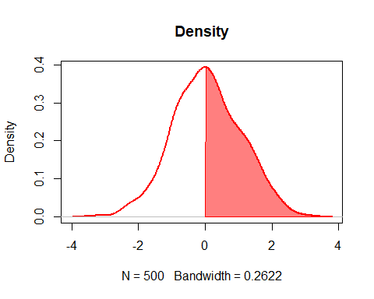
Cumulative density functions
We can talk about cumulative density functions for values - what’s the probability that the pitch peak will be 80 Hz or less?

Slide 60
Cumulative density functions
Many statistical summary values are based on cumulative density functions
(one tailed) p-value: probability of a value this value or lower (according to a hypothetical distribution that corresponds to performing the experiment forever)
95% confidence intervals: probability of value occurring within 0.95 of the probability distribution.

Slide 61
“Conventional” test statistics
Chi-squared statistic (all variables are categorical)
Linear regression (all variables are continuous)
ANOVA (a type of linear model where you just add more lines rather than lines with slopes)
Logistic regression (a type of regression where predictor is continuous and predictor is binary)

Slide 62
Counts and contingency tables
A lot of statistical information comes from counts (e.g. frequency of words in different texts)
Such data are usually presented in a contingency table -Data from Matthew Dryer (1992)

Slide 63
Contingency table
Its easy to make a contingency table in R
wordorder <- cbind(c(107, 7), c(12, 70)) rownames(wordorder) <- c("Postp", "Prep") colnames(wordorder) <- c("OV", "VO") wordorder
## OV VO ## Postp 107 12 ## Prep 7 70

Slide 64
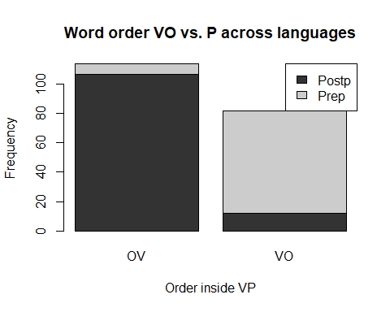
Contingency table (bar plot)
barplot(wordorder, main = "Word order VO vs. P across languages", ylab = "Frequency", xlab = "Order inside VP", col= c("grey20", "grey80")) legend("topright", c("Postp", "Prep"), fill = c("grey20", "grey80"))

Slide 65
Chi-squared test
A chi-squared test just asks whether the associations between the values are better than expected, where “expected” means that the values just associate with each randomly.
To do such a test, we have to construct a null distribution (the “expected” distribution)

Slide 66
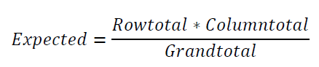
The ‘Expected’ Value
Given the raw counts of the features, how high would we expect the numbers in each of the cells to be, if there was no relations.
The expected frequency refers to what the values would be if VO/OV and Postp/Prep were independent.

Slide 67
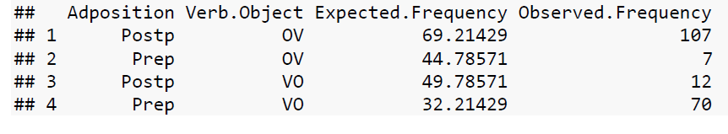
The ‘Expected’ Value

Slide 68
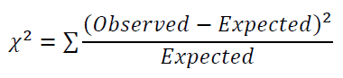
Chi-squared test
## Chisquared test
chisq.test(wordorder)
## ## Pearson's Chi-squared test with Yates' continuity correction ## ## data: wordorder ## X-squared = 122.21, df = 1, p-value < 2.2e-16

Slide 69
The p value
The p value assumes some hypothetical distribution constructed out of a thought experiment where our values are not associated with one another.
The p value reports a cumulative probability of the observed distribution occurring if that hypothetical null was true.
It is the probability of your data assuming the null, not the probability of the hypothesis itself.

Slide 70
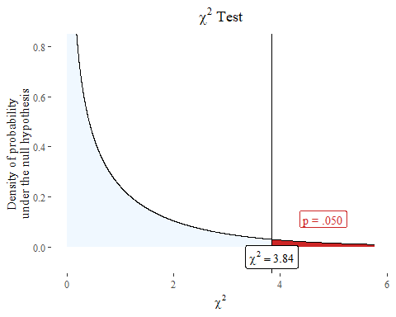
The p value
Imagine the chi-square test being calculated over and over again for ``random” values of OV/VO Prepp/Postp
The higher the chi-squared statistic the lower the p value.

Slide 71
The chi-squared test and p values
From the formula you should be able to tell:
The p value will be lower if there is a larger distance between observed and expected values
The p value will be lower if there are more observations overall, regardless of the difference between observed and expected values

Slide 72
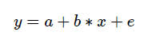
Linear models
A linear model constructs a model where y (dependent variable) increases linearly with x (independent variable).

Slide 73
Linear models
a is the intercept - where the line crosses 0 on the x axis
b is the slope of the line (it is a constant)
x (predictor variable) is a random variable (a set of numbers with a distribution)
y (dependent variable) is a random variable, but a function of the other variables
e (error) is a random variable. It is what makes the formula below a statistical model

Slide 74
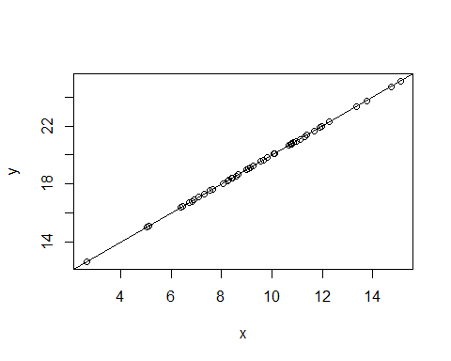
Linear model (perfect prediction)
x <- rnorm(50, m =10, sd = 3) a = 10 b = 1 y <- a+b*x plot(y~x) abline(coef(lm(y~x)))
Notes:
This is what the relationship between x and y looks like if there is no error term.

Slide 75
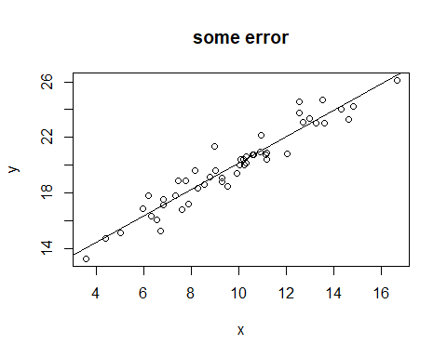
Linear model (some error)
x1 <- rnorm(50, m =10, sd = 3) a1 = 10 b1 =1 e1 <- rnorm(n=50, m=0, sd=1) #Add an error term y1 <- a1+b1*x1 +e1 data2 <- data.frame(x1,y1) plot(y1~x1) abline(coef(lm(y1~x1))) title("some error")

Slide 76
lm(y~x)
## ## Call: ## lm(formula = y ~ x) ## ## Coefficients: ## (Intercept) x ## 10.6101 0.9508

Slide 77
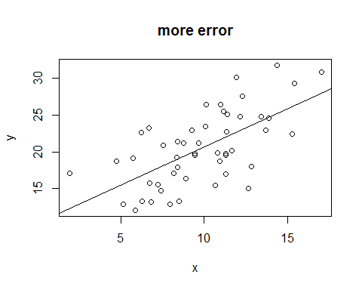
Linear model (more error)
x2 <- rnorm(50, m =10, sd = 3) a2 = 10 b2 =1 e2 <- rnorm(n=50, m=0, sd=4) y2 <- a2+b2*x2 +e2 data3 <- data.frame(x2,y2) data3$group = "large.residuals" plot(y2~x2) abline(coef(lm(y~x))) title("more error")

Slide 78
lm(y~x)
## ## Call: ## lm(formula = y ~ x) ## ## Coefficients: ## (Intercept) x ## 10.291 1.036

Slide 79
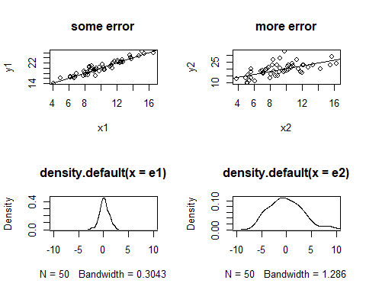
Linear models and error

Slide 80
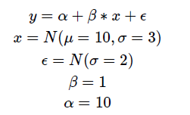
Reading R output
summary(lm(y1~x1))
## ## Call: ## lm(formula = y1 ~ x1) ## ## Residuals: ## Min 1Q Median 3Q Max ## -2.46443 -0.48623 -0.02705 0.49405 2.02559 ## ## Coefficients: ## Estimate Std. Error t value Pr(>|t|) ## (Intercept) 10.26454 0.49234 20.85 <2e-16 *** ## x1 0.98831 0.04702 21.02 <2e-16 *** ## --- ## Signif. codes: 0 '***' 0.001 '**' 0.01 '*' 0.05 '.' 0.1 ' ' 1 ## ## Residual standard error: 0.9142 on 48 degrees of freedom ## Multiple R-squared: 0.902, Adjusted R-squared: 0.9 ## F-statistic: 441.8 on 1 and 48 DF, p-value: < 2.2e-16

Slide 81
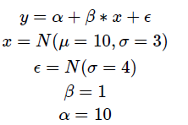
Reading R output
lm(y2~x2)
## ## Call: ## lm(formula = y2 ~ x2) ## ## Coefficients: ## (Intercept) x2 ## 10.2449 0.9903

Slide 82
Length of word and mean reaction time (from Levshina)
ldt <- read.csv("/Users/Adam/Desktop/levshina.ldt.csv", header=T) head(ldt)
## X Length Freq Mean_RT ## 1 marveled 8 131 819.19 ## 2 persuaders 10 82 977.63 ## 3 midmost 7 0 908.22 ## 4 crutch 6 592 766.30 ## 5 resuspension 12 2 1125.42 ## 6 efflorescent 12 9 948.33

Slide 83
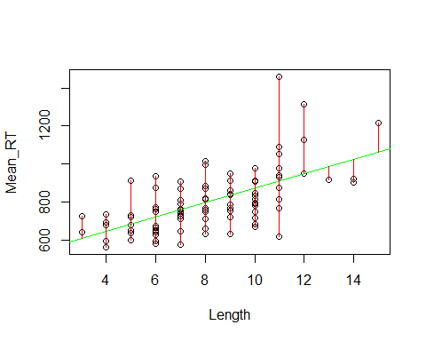
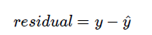
Residuals
Once a model is constructed, each y value can be associated with a residual, which is the distance between the value predicted by the line (the linear model) and the actual value.
attach(ldt) plot(Mean_RT~Length) abline(lm(Mean_RT~Length)
Notes:
Residuals are the red lines

Slide 84
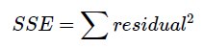
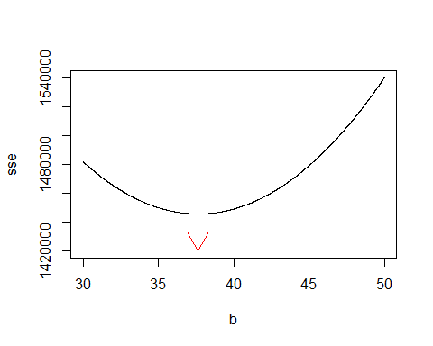
Linear model
A linear model chooses a slope (b) and an intercept (a) that gets the SSE as low as possible.
Sum of squared errors - the distances of the all the residuals added up

Slide 85
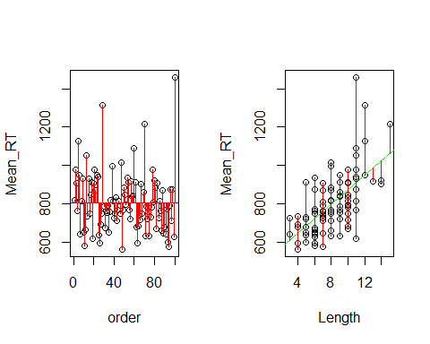
Linear model
The values from a linear model are basically comparing the sum of squared error of just the values of y, to the sum of squared error of the linear model.

Slide 86
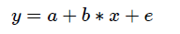
Linear model
summary(lm(Mean_RT~Length))
## ## Call: ## lm(formula = Mean_RT ~ Length) ## ## Residuals: ## Min 1Q Median 3Q Max ## -291.74 -77.81 -3.69 47.92 546.22 ## ## Coefficients: ## Estimate Std. Error t value Pr(>|t|) ## (Intercept) 498.443 41.949 11.882 < 2e-16 *** ## Length 37.644 4.879 7.716 1.02e-11 *** ## --- ## Signif. codes: 0 '***' 0.001 '**' 0.01 '*' 0.05 '.' 0.1 ' ' 1 ## ## Residual standard error: 121.5 on 98 degrees of freedom ## Multiple R-squared: 0.3779, Adjusted R-squared: 0.3716 ## F-statistic: 59.53 on 1 and 98 DF, p-value: 1.019e-11

Slide 87
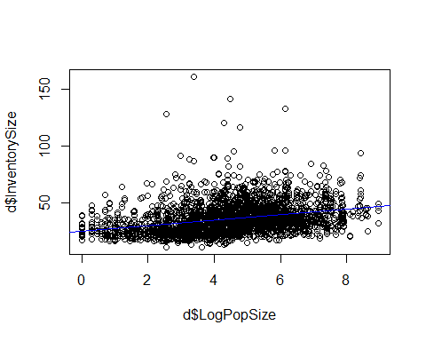
Linear model
d <- read.csv("/Users/Adam/Desktop/phoninv_popsize.tsv", sep="\t") plot(d$InventorySize~d$LogPopSize) abline(lm(d$InventorySize~d$LogPopSize), col = "blue")

Slide 88
## Linear model
summary(lm(d$InventorySize~d$LogPopSize))
## ## Call: ## lm(formula = d$InventorySize ~ d$LogPopSize) ## ## Residuals: ## Min 1Q Median 3Q Max ## -24.905 -8.507 -2.468 6.441 127.716 ## ## Coefficients: ## Estimate Std. Error t value Pr(>|t|) ## (Intercept) 24.8998 0.6562 37.95 <2e-16 *** ## d$LogPopSize 2.4673 0.1361 18.13 <2e-16 *** ## --- ## Signif. codes: 0 '***' 0.001 '**' 0.01 '*' 0.05 '.' 0.1 ' ' 1 ## ## Residual standard error: 12.68 on 2726 degrees of freedom ## Multiple R-squared: 0.1076, Adjusted R-squared: 0.1072 ## F-statistic: 328.5 on 1 and 2726 DF, p-value: < 2.2e-16

Slide 89
Tidyverse and data wrangling
Olena Shcherbakova

Slide 90
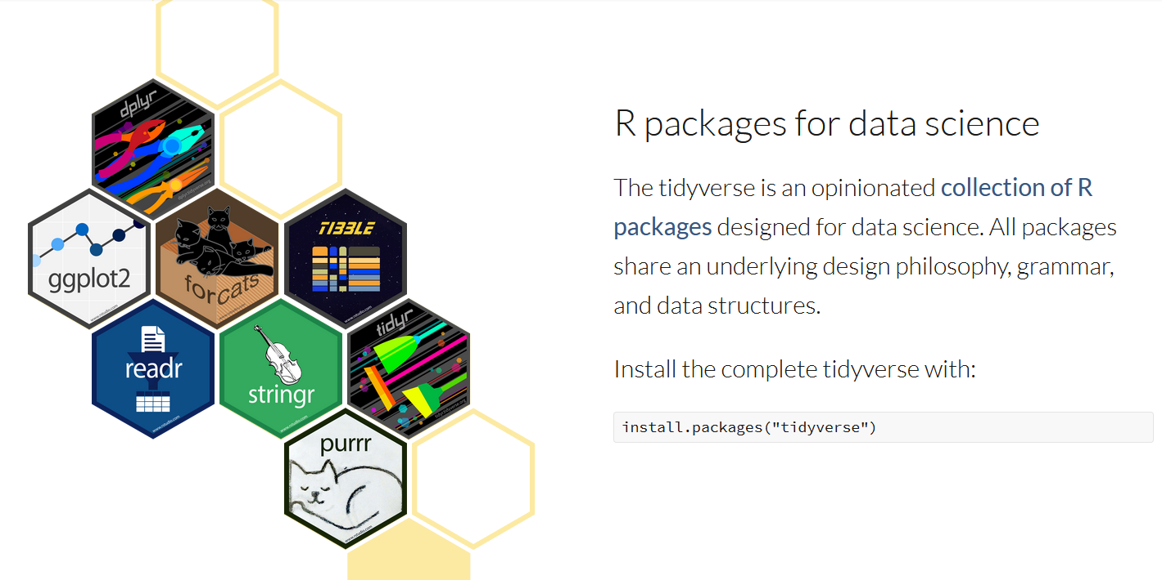
Tidyverse
https://www.tidyverse.org/

Slide 91
Agenda
Overview of tidyverse functions for data wrangling
Walk-through: Glottolog
Data wrangling task
Walk-through: WALS

Slide 92
Data wrangling
Tidying + transforming = data wrangling

Slide 93

https://makeameme.org/meme/when-your-mom-f3yko9

Slide 94

Tidy data
each column: a variable
each row: an observation
each cell: a value
https://bookdown.org/ansellbr/WEHI_tidyR_course_book/week3.html

Slide 95
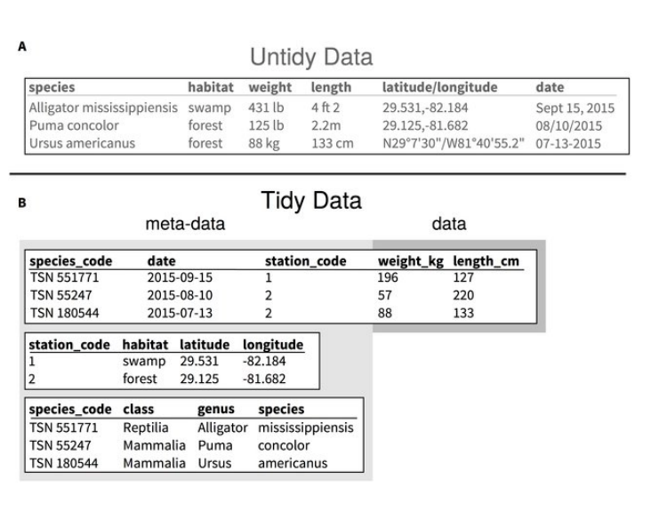
Tidy data
Hart et al. 2016

Slide 96
Transforming data
Pipe: %>%
Reshaping data: pivot_longer and pivot_wider
Joining dataframes: *_join
Separating and uniting columns: separate and unite
Subsetting the rows based on a condition: filter
Selecting & removing columns: select
Create new variables (columns) and modify existing ones: mutate combined with ifelse, case_when, and recode)

Slide 97

The pipe operator %>%
a shortcut: CMD + SHIFT + M (mac) or CTRL + SHIFT + M (pc)
The pipe (%>%):
1) feeds the wals dataframe into rename function
2) feeds the output of rename into relocate function
wals <- read_delim(
"data/cldf_wals/languages.csv") %>%
rename(Language_ID = "ID") %>%
relocate(Name, everything())
https://bookdown.org/ansellbr/WEHI_tidyR_course_book/welcome-to-r.html#the-pipe
https://unsplash.com/photos/DByY8MbE9OE

Slide 98
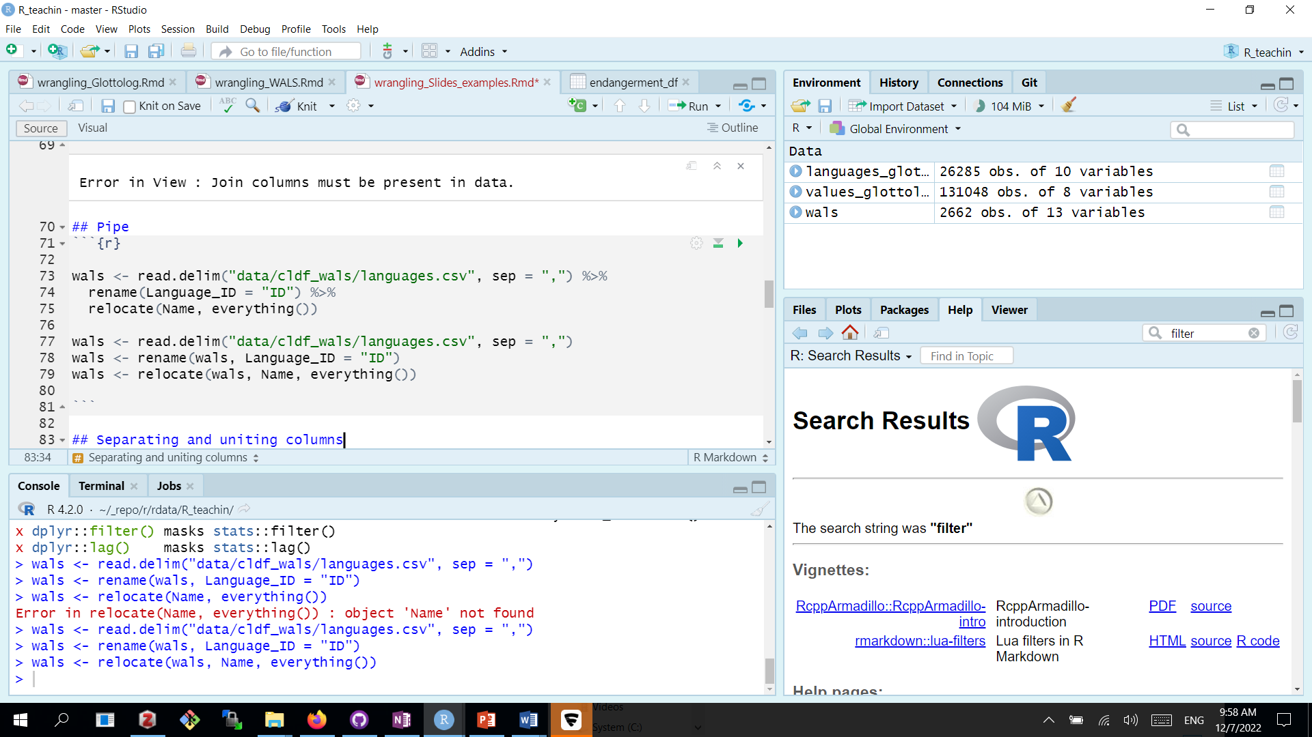
The pipe operator %>%
with pipe
without pipe
- assigning the result to the new object/rewriting the old object
- repeating the object (dataframe name)

Slide 99
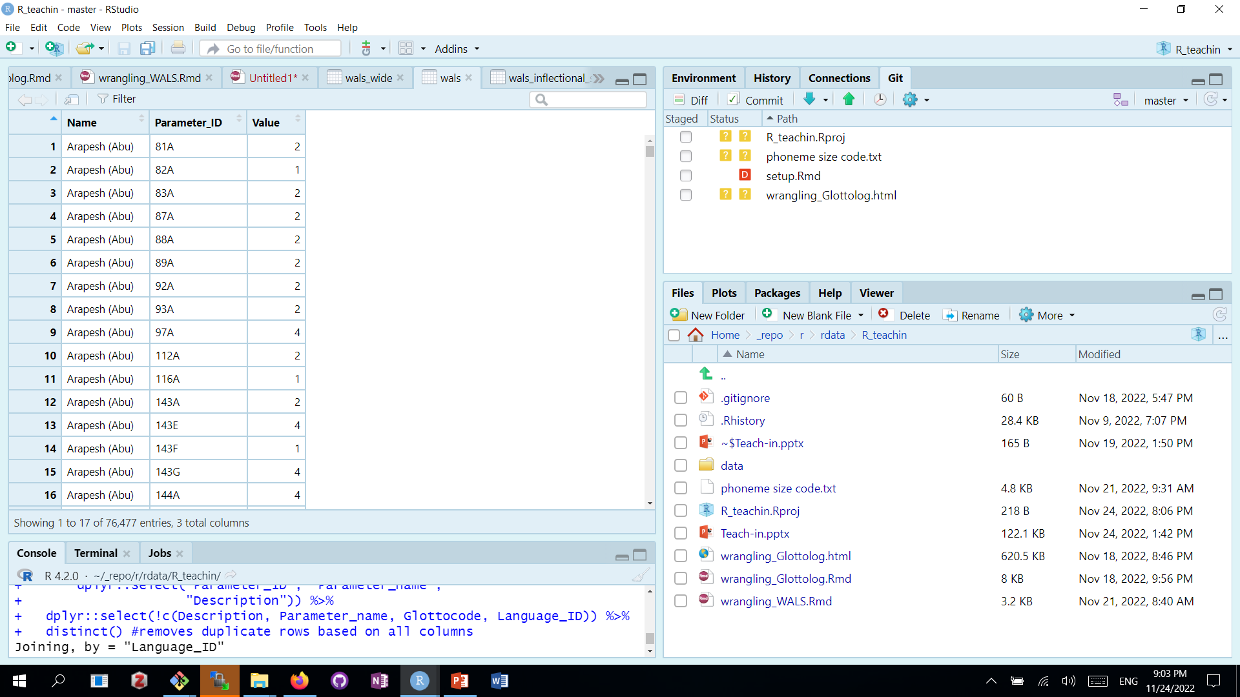
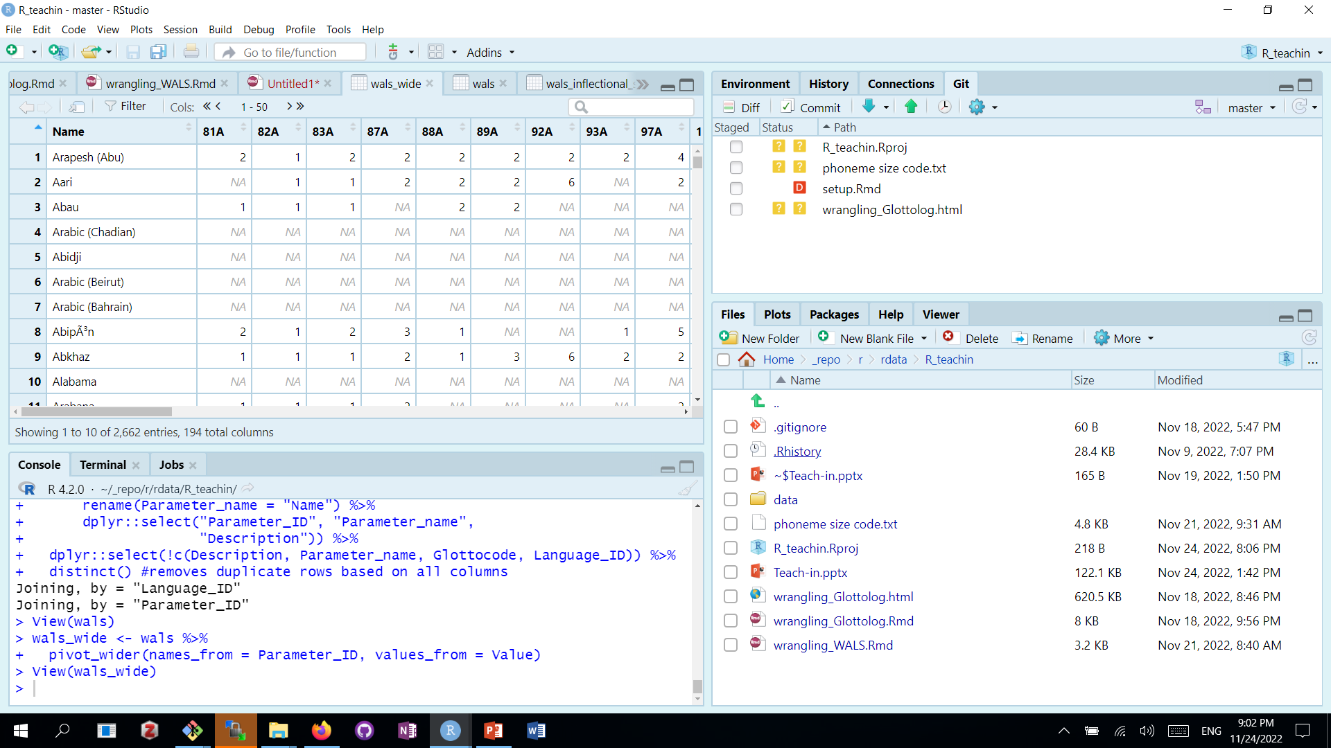
Reshaping data
long
wide

Slide 100
Reshaping data
long
wide

Slide 101
Reshaping data
wals_wide <- wals %>%
pivot_wider(
names_from = Parameter_ID,
values_from = Value)
wide

Slide 102
Reshaping data
wals_long <- wals_wide %>%
pivot_longer(
cols = !Name,
names_to = "Parameter_ID",
values_to = "Value")
long

Slide 103
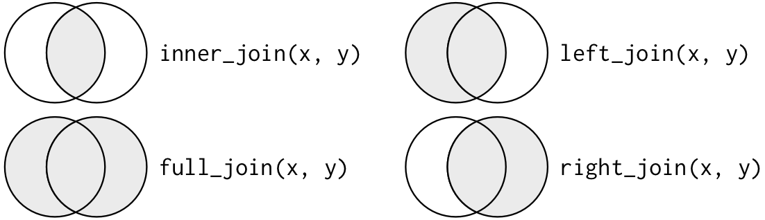
Joining dataframes
https://jmsallan.netlify.app/blog/joining-relational-tables-in-dplyr/

Slide 104
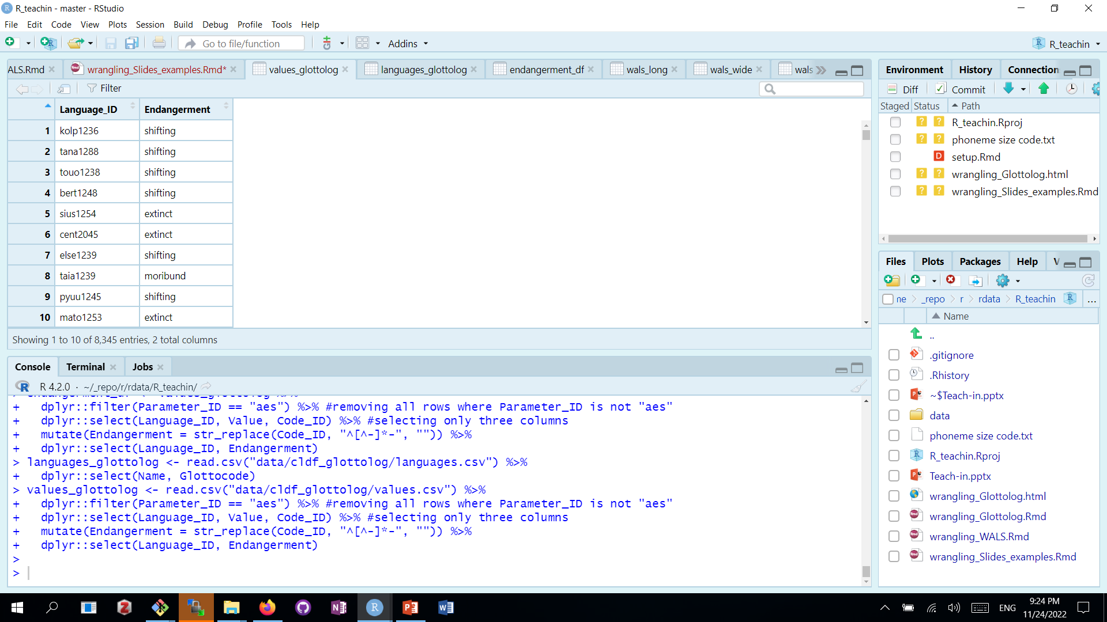
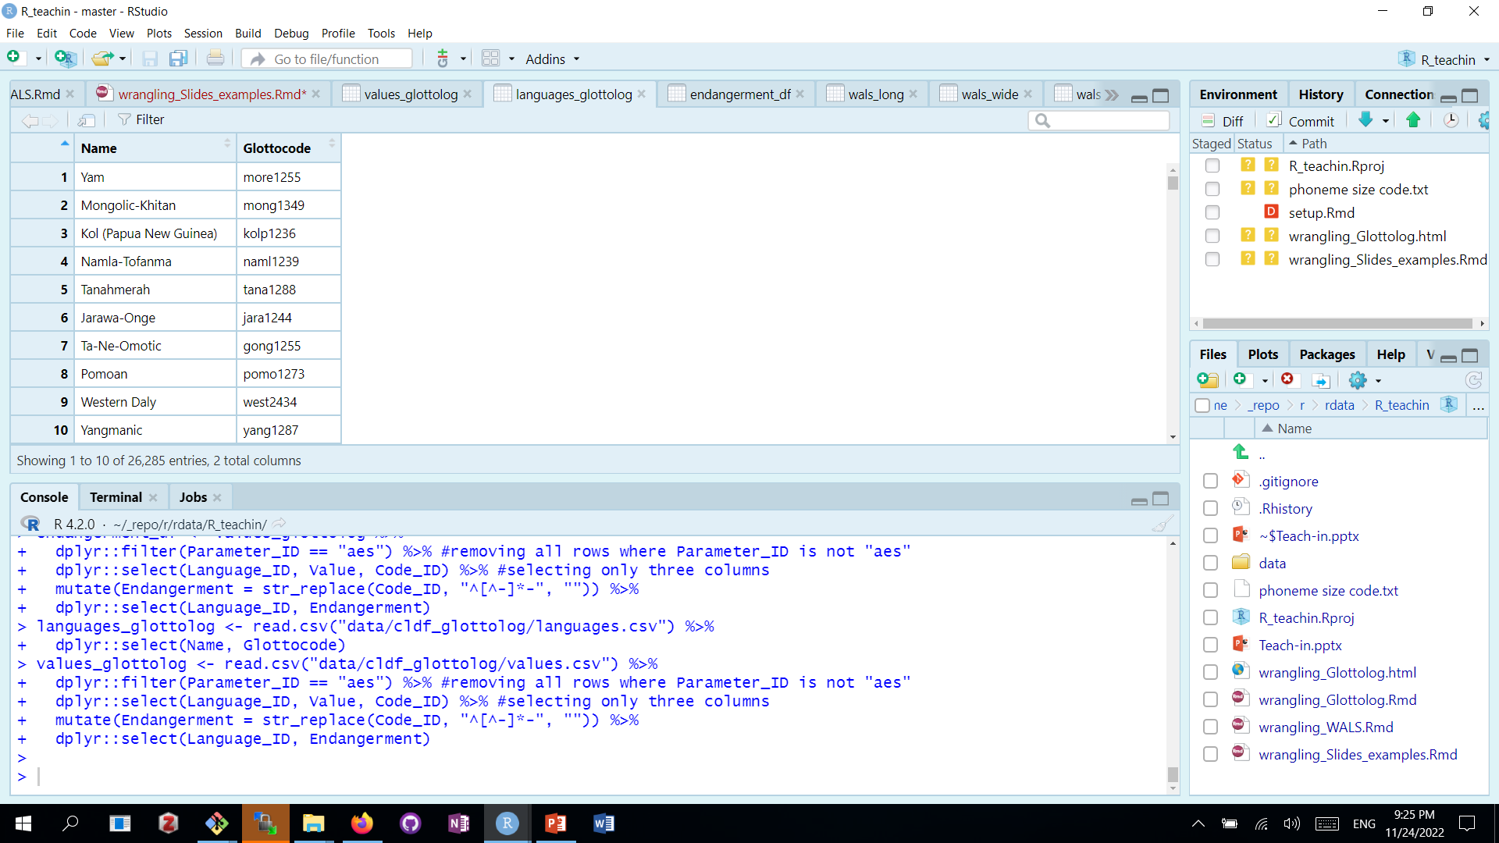
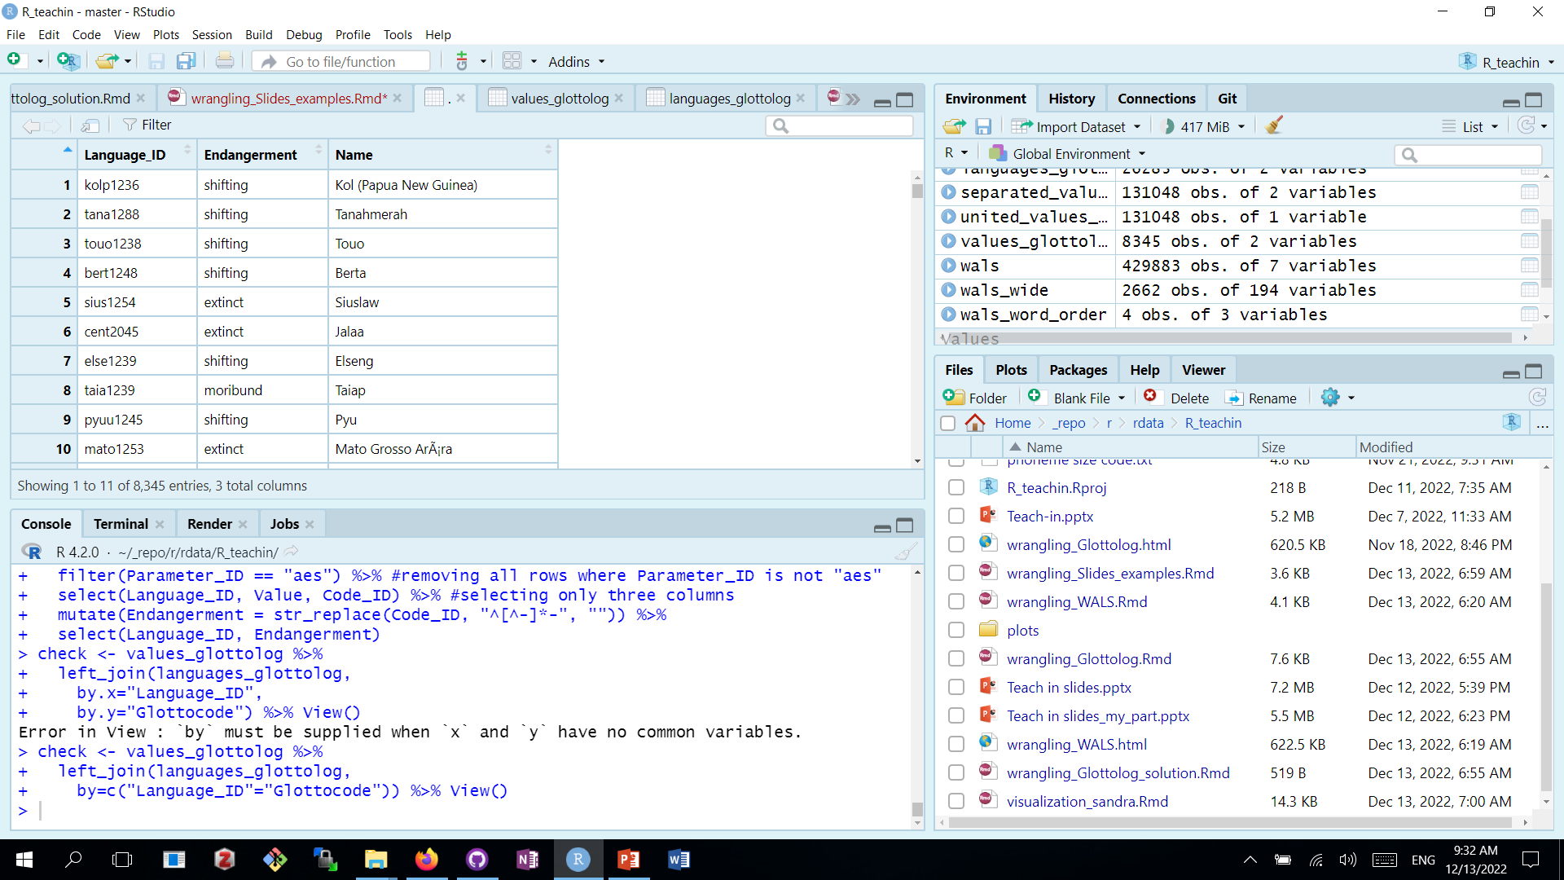
Joining dataframes
values_glottolog %>%
left_join(languages_glottolog,
by=c("Language_ID"="Glottocode")) %>%
View()
View(values_glottolog)
View(languages_glottolog)

Slide 105
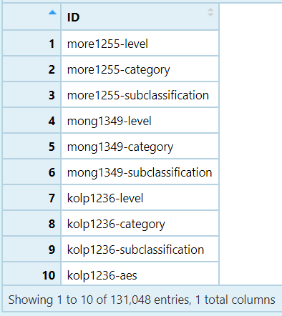
Separating and uniting columns
values_glottolog <- read_csv("data/cldf_glottolog/
values.csv") %>%
select(ID)

Slide 106
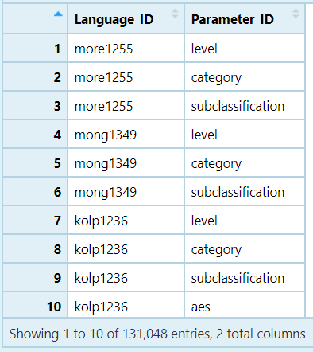
Separating and uniting columns
sep_values_glottolog <-
values_glottolog %>%
separate(ID,
c("Language_ID", "Parameter_ID"),
sep = "-")
values_glottolog <- read_csv("data/cldf_glottolog/
values.csv") %>%
select(ID)

Slide 107
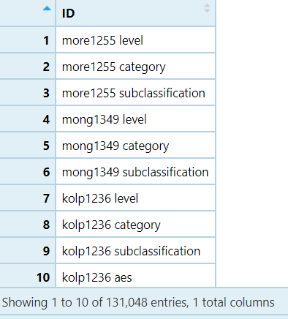
Separating and uniting columns
sep_values_glottolog <-
values_glottolog %>%
separate(ID,
c("Language_ID", "Parameter_ID"),
sep = "-")
values_glottolog <- read_csv("data/cldf_glottolog/
values.csv") %>%
select(ID)
united_values_glottolog <- sep_values_glottolog %>%
unite(ID, sep = " ")

Slide 108
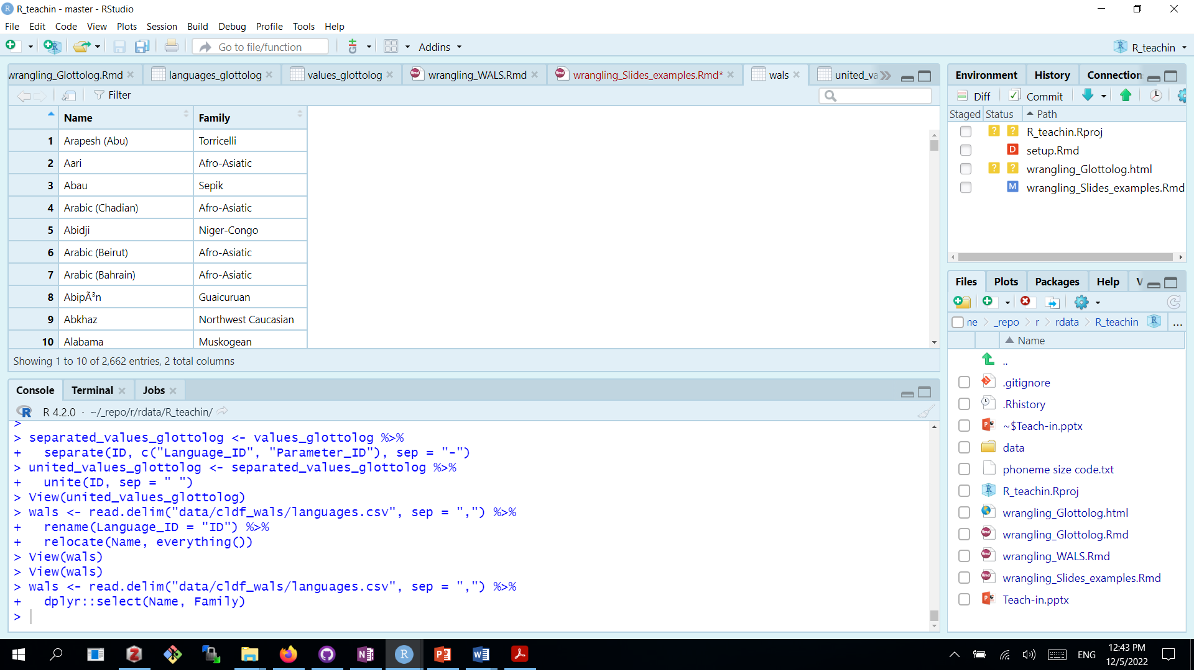
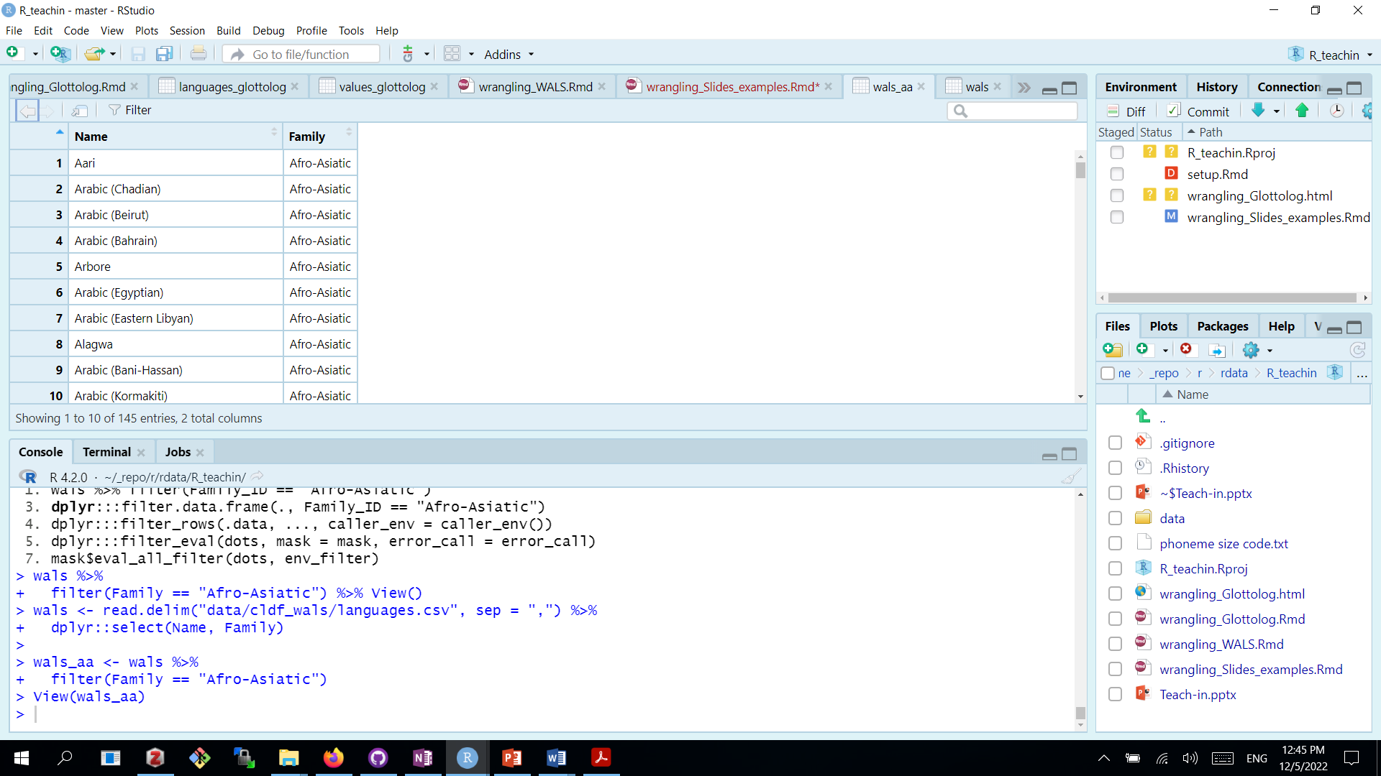
Selecting columns and Subsetting the rows
wals <-read_delim("data/cldf_wals/languages.csv") %>%
select(Name, Family)
wals_aa <- wals %>%
filter(Family == "Afro-Asiatic")

Slide 109
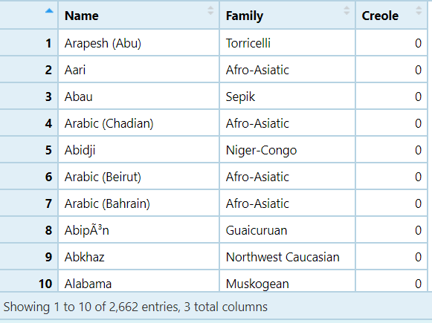
Create new variables and modify existing ones
wals <- read_delim("data/cldf_wals/languages.csv“) %>%
select(Name, Family)
wals %>%
mutate(Creole =
ifelse(str_detect(Name, "Creole"), 1, 0)) %>% View()

Slide 110
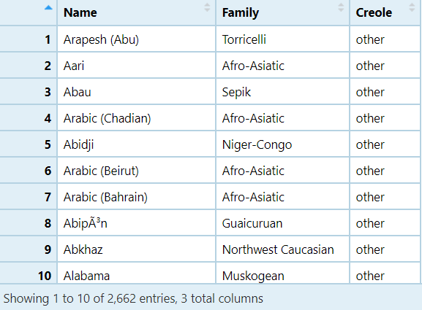
Create new variables and modify existing ones
wals <- read_delim("data/cldf_wals/languages.csv") %>%
select(Name, Family)
wals %>% mutate(Creole =
case_when(
str_detect(Name, "Creole") ~ "Creole",
str_detect(Name, "Pidgin") ~ "Pidgin",
TRUE ~ "other")) %>% View()

Slide 111
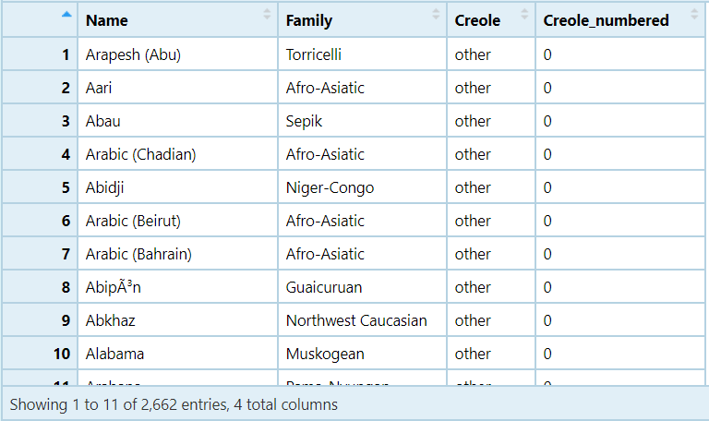
Create new variables and modify existing ones
wals %>% mutate(Creole =
case_when(str_detect(Name, "Creole") ~
"Creole",
str_detect(Name, "Pidgin") ~ "Pidgin",
TRUE ~ "other")) %>%
mutate(Creole_numbered =
recode(Creole,
"Creole" = "1",
"Pidgin" = "2",
"other" = "0")) %>% View()

Slide 112
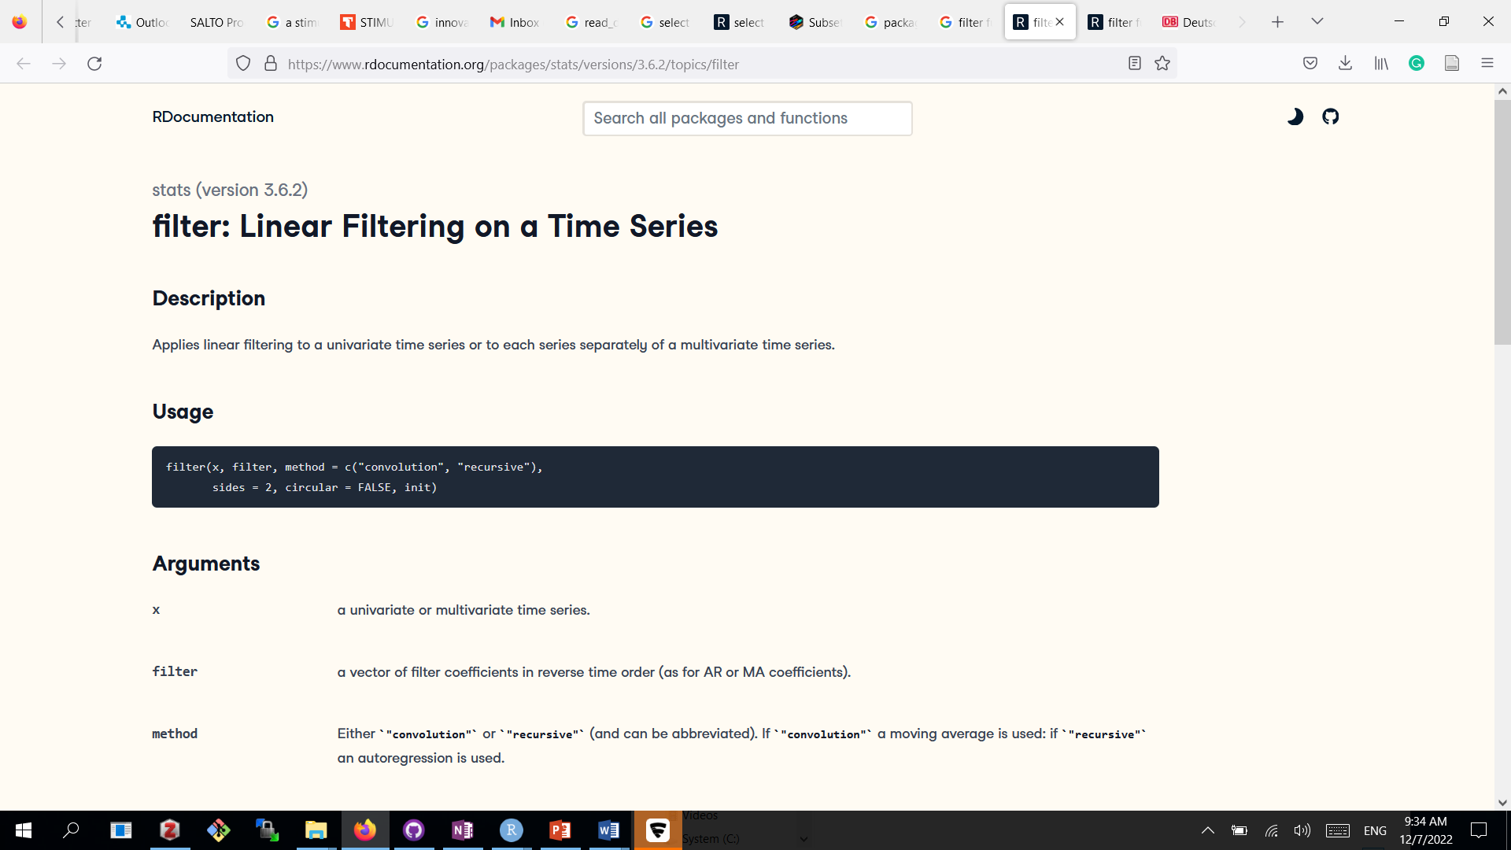
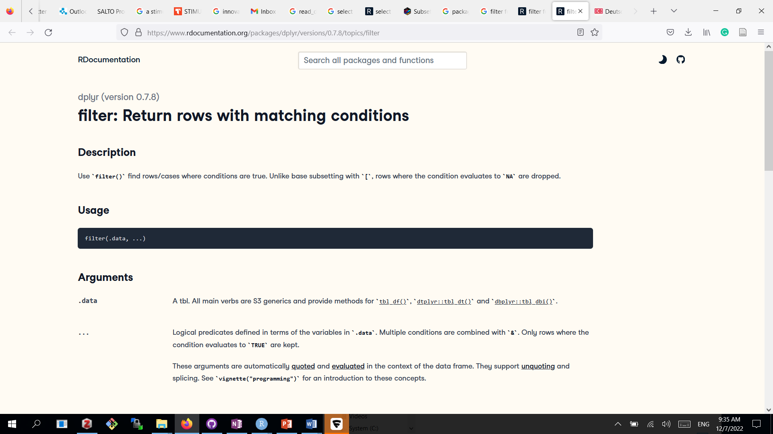
Packages: naming conflicts
stats::filter()
dplyr::filter()

Slide 113
Data visualization and maps with ggplot2
Sandra Auderset

Slide 114
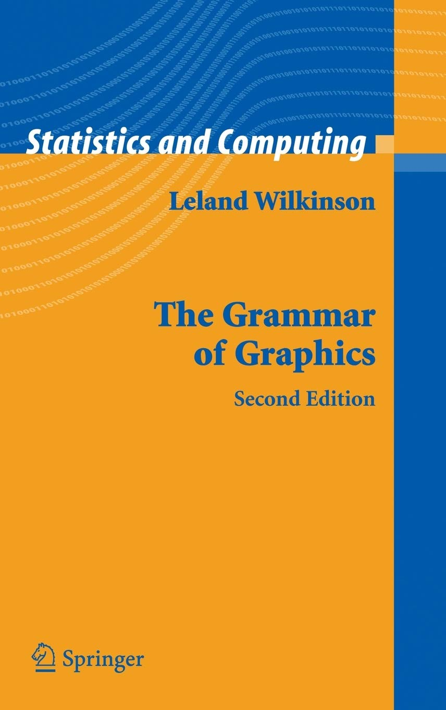
What is ggplot2?
“A system for 'declaratively' creating graphics, based on "The Grammar of Graphics". You provide the data, tell 'ggplot2' how to map variables to aesthetics, what graphical primitives to use, and it takes care of the details.”
now part of the Tidyverse, but pre-dates it and can just as well be used with base R
more details and cheat sheets: CRAN - Package ggplot2 and https://ggplot2.tidyverse.org/

Slide 115
Advantages of ggplot2 over base R plotting
allows faster and more extensive fine-tuning of figures
better export options
continuously developed, very active community
many extension packages for more specific needs, e.g.:
ggmap: for making beautiful maps
ggpubr: for easily creating publication-ready figures
ggthemes: predefined plot layouts for various purposes
ggsci: color palettes from scientific journals
gganimate: for animated graphics
etc. (currently 118 in total: https://exts.ggplot2.tidyverse.org/gallery/ )

Slide 116
Basic elements of a ggplot2 figure
ggplot(data = <df>, aes(x = <values>, y = <values>, col = <color>)) +
geom_<type of plot>(<plotting options>) +
<extra options> +
theme_<type of theme>
aes = aesthetics
+ = ggplot-specific pipe (like “%>%”; leftover from pre-tidyverse era)

Slide 117


Example with categorical data

Slide 118


Example with continuous data

Slide 119
The basics of maps with ggmap
ggmap is a function in ggplot2 (same basic set up and logic as other plots)
based on static maps from Google Maps, OpenStreetMap, Stamen Maps
to use Google Maps, you need to register an API key with Google Cloud (more infos here: https://rpubs.com/jcraggy/841199 )
OpenStreetMap and Stamen Maps can be called by R directly
useful supplementary package: ggrepel - for automatically placing labels so they don’t overlap

Slide 120
The basics of maps with ggmap
Step 1: create the base map
mymap <- get_map(location = c(lon = <longitude>, lat = <latitude>),zoom = <zoom factor>, scale = <map scale>, maptype = <type of map background>,source = <source of map (osm, google, stamen)>)
Step 2: plot the map and Step 3: add information
ggmap(mymap)+
geom_point(aes(x = <latitude>, y = <longitude>, color = <groups>), data = <df>, size = <point size>)

Slide 121


Example with ggmap

Slide 122
The basics of world maps with ggplot2 and maps
Step 1: get map data and create the base map
base <- ggplot() +
coord_fixed() +
geom_polygon(data = map_data("world"), aes(x = long, y = lat, group =
group))
Step 2: add points
my_map <- base +
geom_point(data = <data>, aes(x = <longitude>, y = <latitude>), size
= etc.) +
theme_map()

Slide 123


Example with a world map

Slide 124
Exporting figures to put in your paper
Basic considerations for figures that will appear in a paper:
high resolution: usually 300 or 600 dpi
figure must fit on A4/Letter page
png (or svg) format
fortunately, ggsave() is here to save you!
ggsave(<file name>, plot = <plot name>, device = <image format>, path = <file path>, scale = <>, width = <>, height = <>, units = <units for height/width>, dpi = <>)

Slide 125
Practice session
Sandra and Adam

Slide 126


Multilevel / random effects model
Here is our linear model, with some made up constants and distributions

Slide 127
Multilevel / random effects model
Here is our linear model, with some made up constants and distributions

Slide 128
Multilevel / random effects model
The intercept and the slope are just constants they are fixed effects in the model

Slide 129


Multilevel / random effects model

Slide 130
Multilevel / random effects model

Slide 131
Multilevel / random effects model
Intercept and/or slope is a random variable (the effects of our original model are modelled as coming from a random distribution)
To model something as a random distribution we have to have multiple instances of it.
We have a bunch of linear regressions one for each “group” and the slopes and intercepts are allowed to vary according to some distribution.

Slide 132

Multilevel / random effects model

Slide 133
Multilevel / random effects model
Why not just do lots of individual linear regressions?
You are doing lots of linear regressions, but then adjusting the values based on data across the groups
That is there is one level where each group gets its own linear regression, and then a higher level

Slide 134
Clause linkage typology using NeighborNets
Research question:
“Do different clause linkage constructions fall into broad categories like subordination, coordination, and cosubordination?”
Source:
Balthasar Bickel. 2010. Capturing particulars and universals in clause linkage typology. In Bril (ed.): Clause Linking and Clause Hierarchy: Syntax and pragmatics

Slide 135
Clause linkage typology using NeighborNets
Data:
69 clause linkage constructions
from
24 languages
Variables:
scope of illocutionary operators
scope of tense/status operators
finiteness
marking of illocutionary operators inside dependent clauses
marking of tense/status operators inside dependent clauses
symmetry (range of categories in linked clauses)
questions and focus allowed inside dependent clauses
extraction of elements of the dependent clause
focus marking in dependent clauses
position of the dependent clause
layer

Slide 136


NeighborNets - R vs. SplitsTree
there is now a neighbornet function implemented in the R package phangorn
BUT
neighborNet is still experimental. The cyclic ordering sometimes differ from the SplitsTree implementation.
SO
we use R to prepare the data and create the distance matrix, then we move over to SplitsTree to create and visualize the neighbornet

Slide 137



NeighborNets and how to read them
algorithm based on neighbor joining that construct networks
input: distance matrix
determines which two edges (taxa) can be connected to a new node based on them being the least distant ones compared to any other combination of edges in the network
repeats until no edges left to join
reticulation represents conflicting signal

Slide 138

NeighborNet of constructions

